Slide 1
Don’t Wait for Godot:
Leading a Special Collections Donor Program without a Development Officer
By Aaron D. Purcell

Slide 2
Today’s Program
Introductions
Value of Archives
Fundraising Principles
Library Donor Program at Virginia Tech
10 Steps for Building Donor Programs in Archives
Defining a Donor Program
Questions/Comments
Group Activity

Slide 3
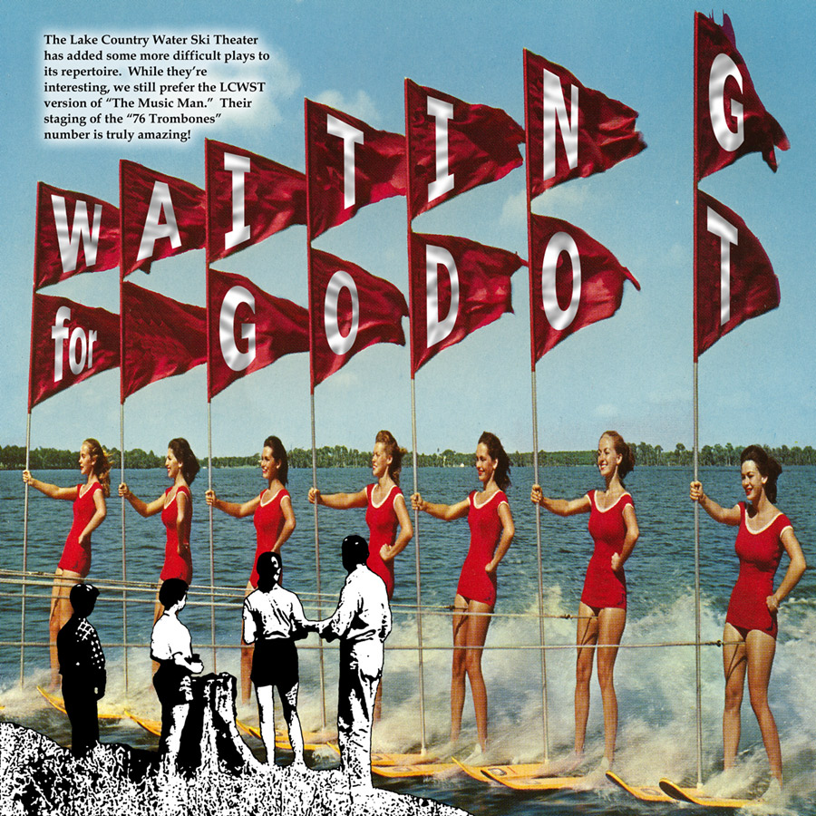
Who is Godot?

Slide 4
Lessons from Godot
Security in doing nothing
Someone could possibly solve all of our problems, whatever they are
Known by reputation only
Donors may be waiting
Special collections archivists may be waiting
Deans and directors may be waiting
Development officers may be waiting

Slide 5
Who I Am, Why I’m Here

Slide 6
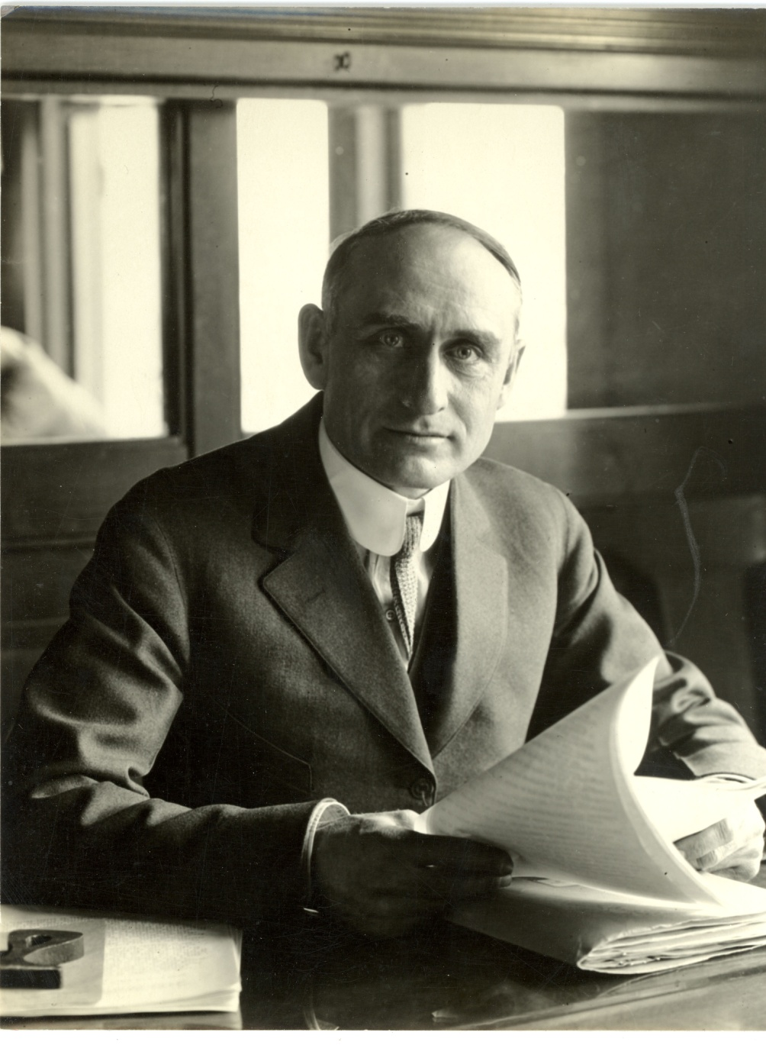
Who is this man?

Slide 7
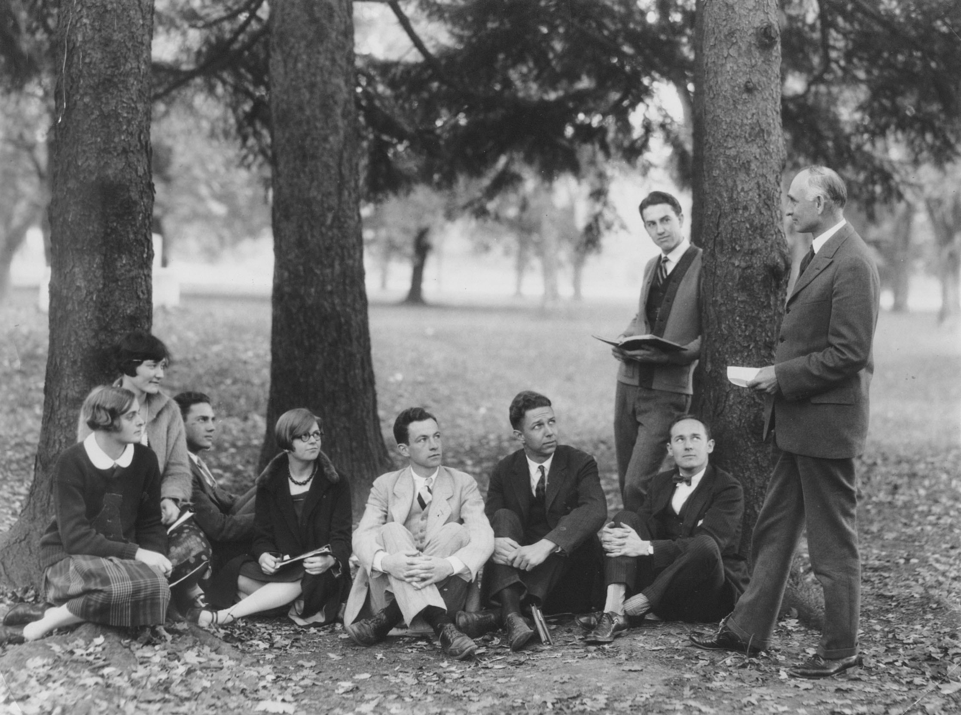
Principled But Planless

Slide 8
Central Development and Libraries
Partners working with, not against, each other
Clarity on what to ask for
Clarity on who to ask
Passing baton
Making and keeping promises
Small potatoes and big gifts
Legacy building

Slide 9
Value and Power of Archives
Wide ranging appeal
Connect multiple generations of researchers
The concept of permanent preservation and access
Outreach to community
Always something “new” in vibrant programs
Unique online resources
Centerpiece of many library development initiatives

Slide 10
Fundraising Principles, part 1
Support a sound educational program
Belief in the quality of the institution
Funding for service
Ask for legitimate needs
Fundraising supports the classroom and laboratory
24/7, 365 organized effort
Perspiration and inspiration
Everybody’s responsibility

Slide 11
Fundraising Principles, part 2
Only way to raise money is to ask for it, ask often
The virtue of giving as well as the necessity of giving
Fundraising important
Good PR for effort
Intensive, not high pressure
Development program long-term
Fundraising a function

Slide 12
Source of Principles
John A. Pollard, Fund-Raising for Higher Education (New York: Harper Brothers, 1958).
See also: Harold J. Seymour, Designs for Fund-Raising (New York: McGraw-Hill, 1966).

Slide 13
University Libraries at Virginia Tech
Development Office and Library
Recent Capital Campaign
Exceeded goals, programs, building donor base, annual giving
Without development officer since 2011

Slide 14
Since 2011
New leaders in library
Ongoing searches
Support for donor events
Reporting on activities
Planning for a donor program
Making small victories
Shared responsibility
Taking the lead in library
Still waiting, but not really

Slide 15
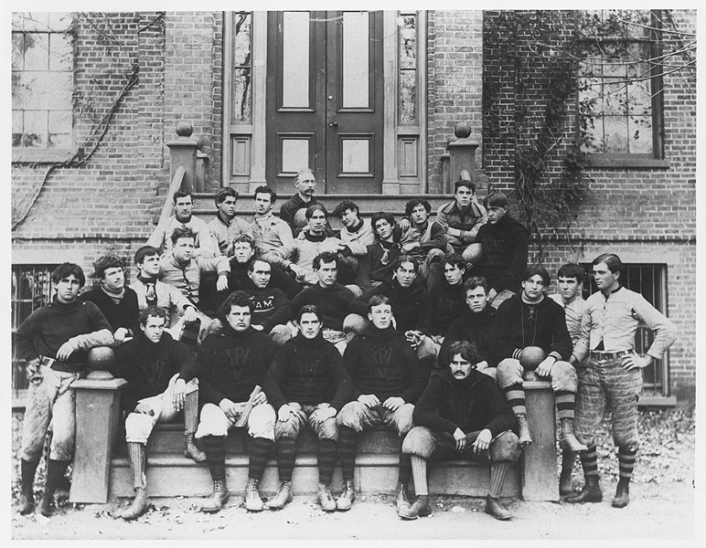
#1. Stop waiting, form a team

Slide 16
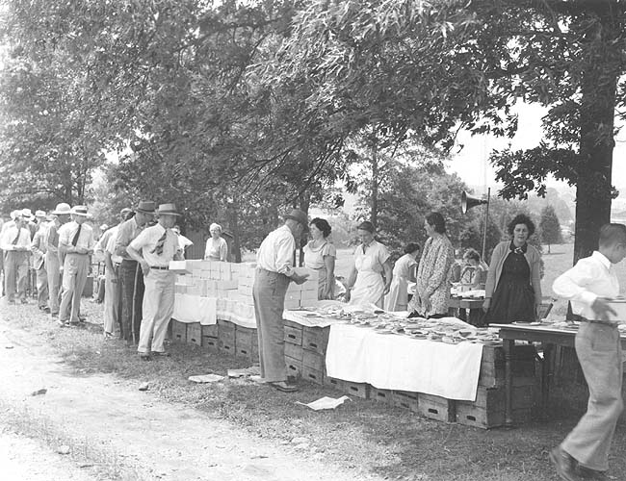
#2. Plan modest events

Slide 17
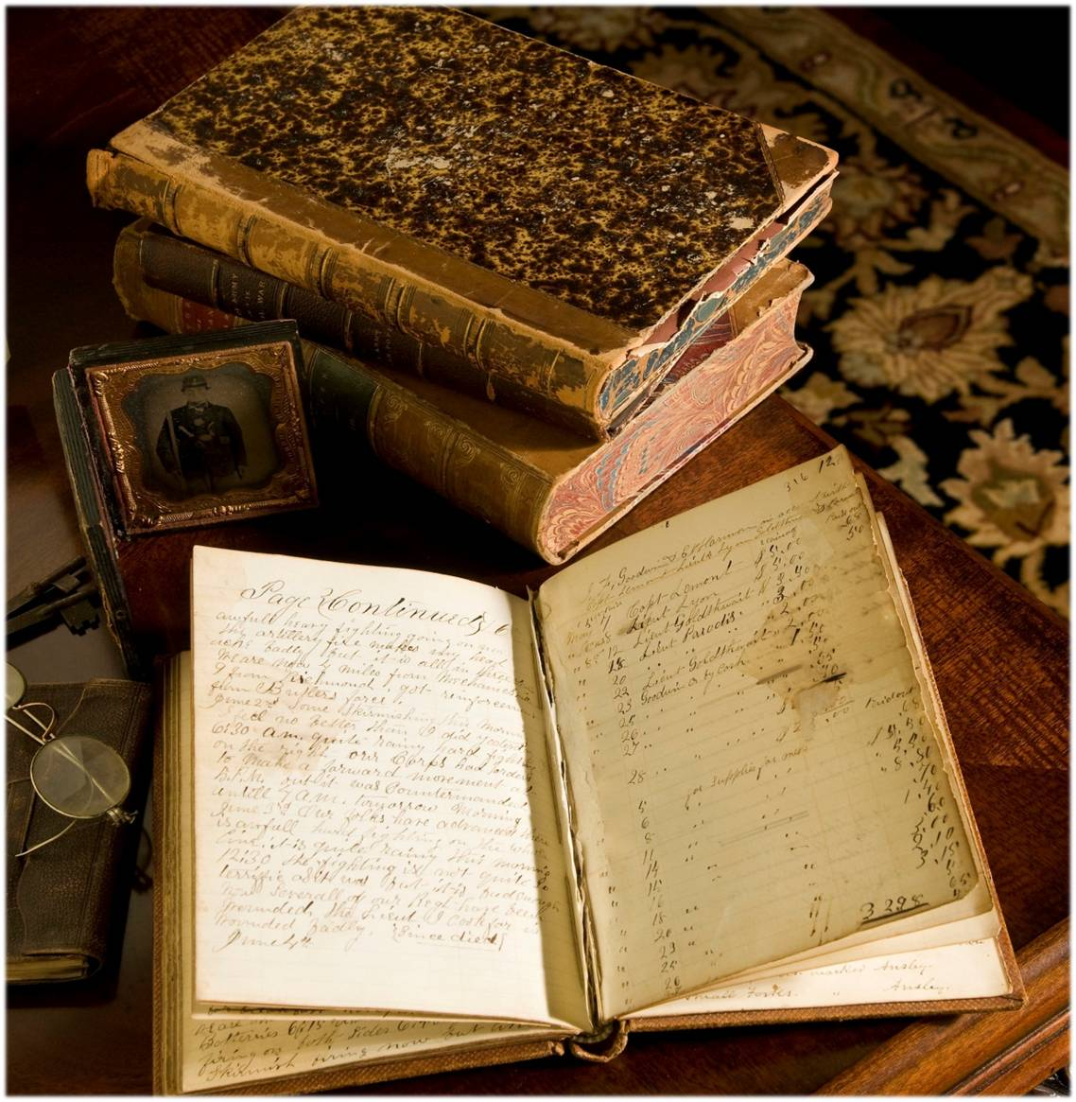
#3. Let the collections speak for themselves

Slide 18
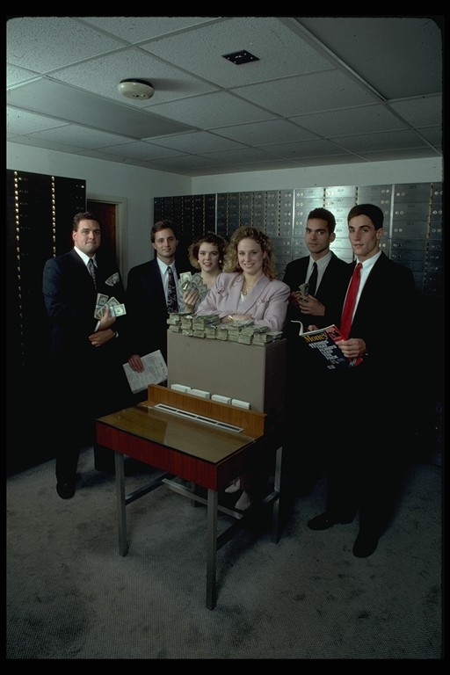
#4. Add $$$ to the mix

Slide 19
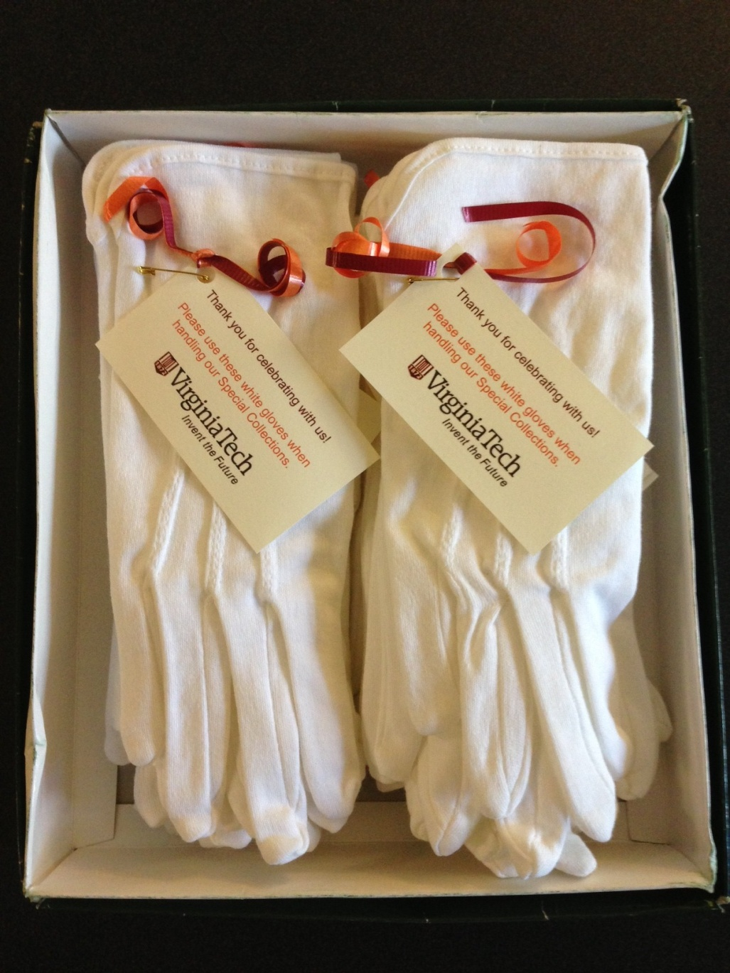
#5. A personal touch, means oh so much

Slide 20
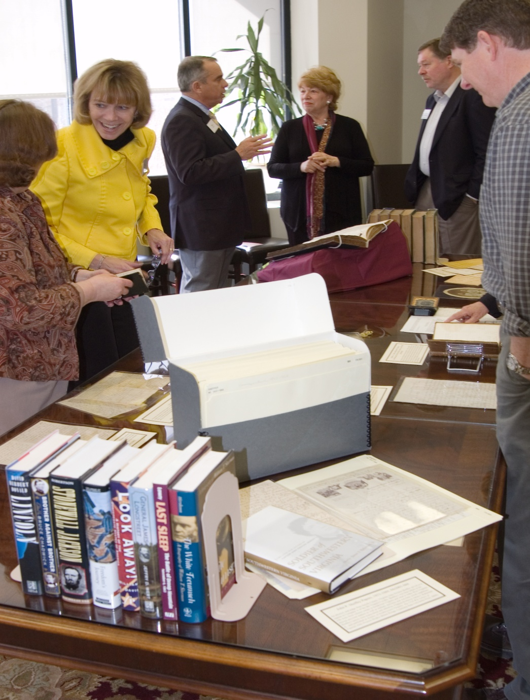
#6. Tours, events, and open house programs

Slide 21

#7. Make the most of travel

Slide 22
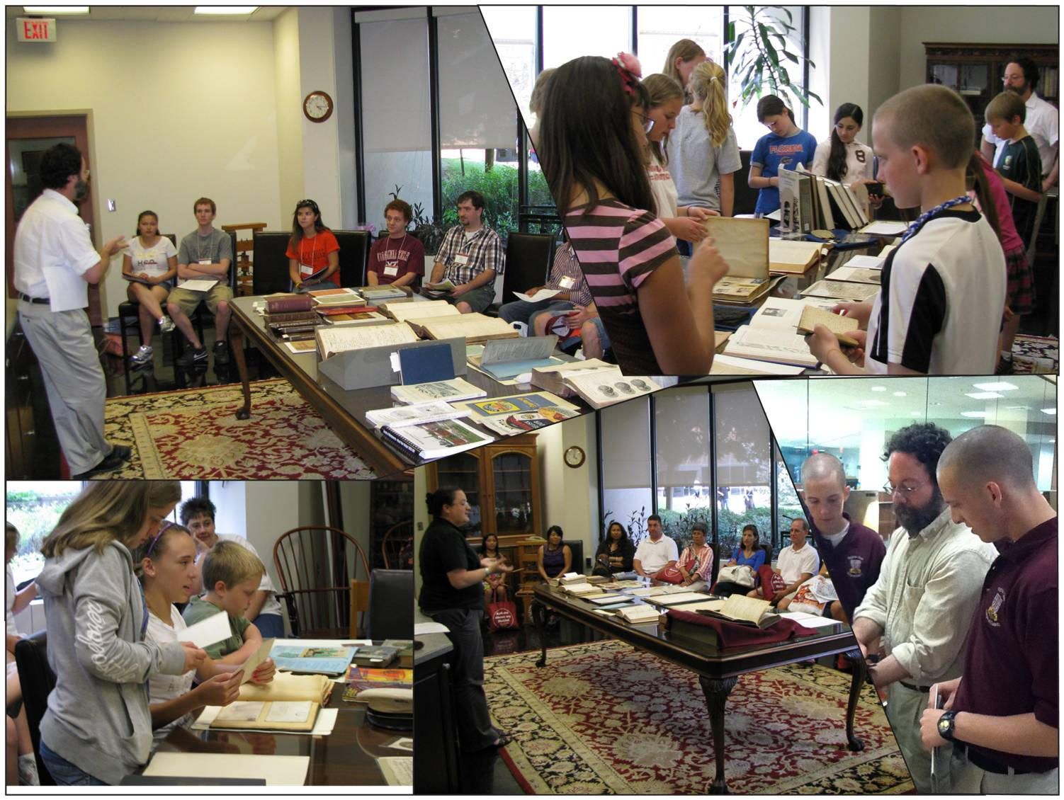
#8. Outreach and Instruction

Slide 23
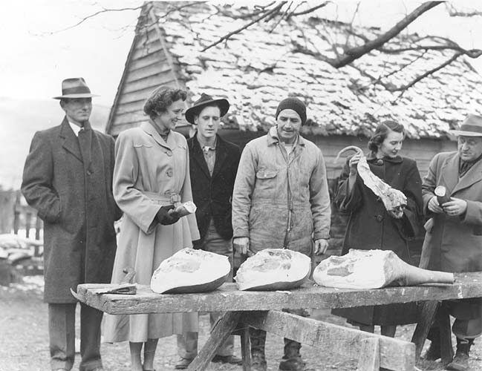
#9. Quality not quantity

Slide 24
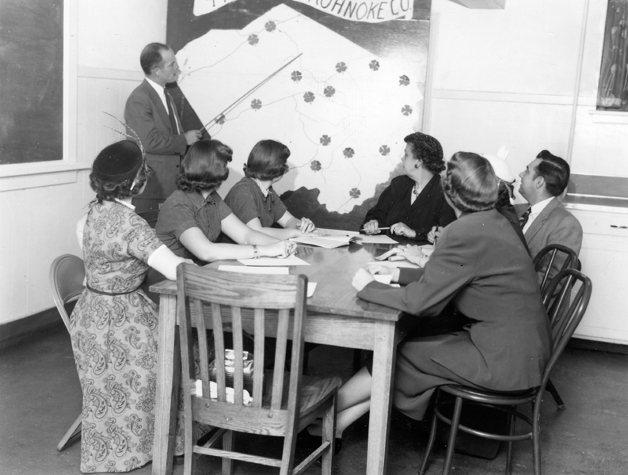
#10. Have a plan, change the plan

Slide 25
10 Tips for Success
Stop waiting, form a team
Plan modest events
Let the collections speak
Add $$$ to the mix
A personal touch means oh so much
Public programs
Make the most of travel
Outreach and instruction
Quality not quantity
Have a plan, change the plan

Slide 26
A Donor Program for Archives
Fundraising strategy
Collection development clarity
Proactive approaches to identifying and cultivating donors
Outreach plan that is focused and realistic
Cooperation with institutional development office (and officer, when available).

Slide 27
Take Aways
Don’t wait, be proactive
Have a plan, build a donor program
See who else is waiting or proceeding, work together
Simple works

Slide 28
Don’t Wait for Godot
Questions/comments on the presentation

Slide 29
Group Activity (20 min)
Form small groups
Pick a reporter in each group
Share your experiences and programming efforts with archives (good/bad)
Formulate a short list of activities and programs to better connect your development program with your archives program
Report a few examples from each group

Slide 30
Thank You
Aaron D. Purcell, Ph.D.
Director of Special Collections
University Libraries
Virginia Tech
P.O. Box 90001
Blacksburg, VA 24062
adp@vt.edu
540-231-9672 (w)

